Slide 1
UXG Formative Study Report
May 20, 2020

Slide 2
Summary of Issues

Slide 3
Issue Summary
Text heavy sections rejected by participants.
Terminology: unknown words, acronyms, phrases
Unfamiliar with concept of Playbooks.
ISO diagram inconsistent with workflow.
Missing or out of order steps in the checklists.
Unclear what the goal of collecting the clinical reminder data is, and it is stated too late in the process.
Curious what the 14 heuristics are, link not found by participants.
Would be more useful if the information accurately mirrored actual job tasks.
On long pages the user becomes disoriented.

Slide 4
Method

Slide 5
Test Method
6 participants were scheduled for participation. The first session was cut short due to audio problems.
Participant roles included: CAC (1), Informaticist (4), Lab ADPAC (1).
All sessions were conducted over Skype between May 15-21, 2020.
No audio recordings were made.
Participants reviewed a consent form and verbally agreed to continue.
Participants performed a think aloud with mouse control of the InVision prototype (link: https://invis.io/HUXB9VX48RJ).

Slide 6
Consent Agreement
I voluntarily agree to participate in an evaluation being conducted by the HFE team.
I authorize the HFE team to keep, preserve, use in any manner and dispose of the findings from this evaluation, including my feedback and opinions expressed. The HFE team will not associate my name or organization name with the results of this evaluation.
I give my permission to make screen video and audio records of me during this evaluation. I understand that these recordings can be used only for evaluation purposes and can be used for no other purpose without my knowledge and consent.
I understand that my participation is completely voluntary. I understand that I can stop participating and that I may leave at any time. I agree to immediately raise any concerns or areas of discomfort with the study administrator.

Slide 7
Detailed Task Findings

Slide 8
Action Plan Content team will address using simpler, less difficult language .Jargon will be avoided. The final site will have click definitions available for selected terms.
1. Unfamiliar Words and Acronyms
Playbooks
UX
UX Methods
User Experience Process
Personas
Clinical Reminder
CRDT
Aims of CRDT
Fundamental Concepts
Methods
Training
Case Studies
Artifacts
Heuristics
Heuristic checklist
Heuristic review
Research Users
Iterative
Approach
Instrument
Participants requested pop-windows when words are clicked on to see the definition in the Glossary or hover tools that provide a definition when they hover over the word.

Slide 9
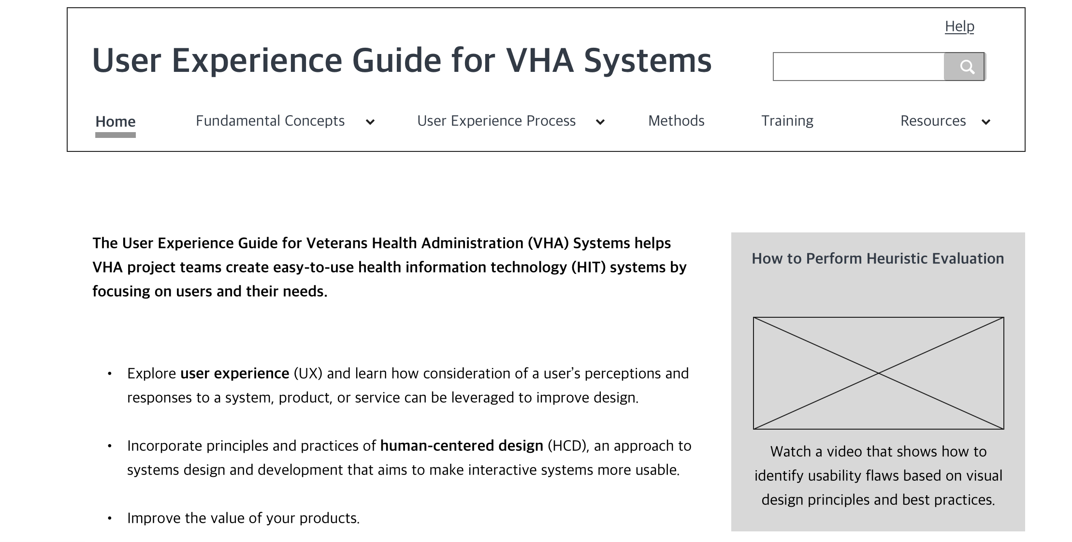
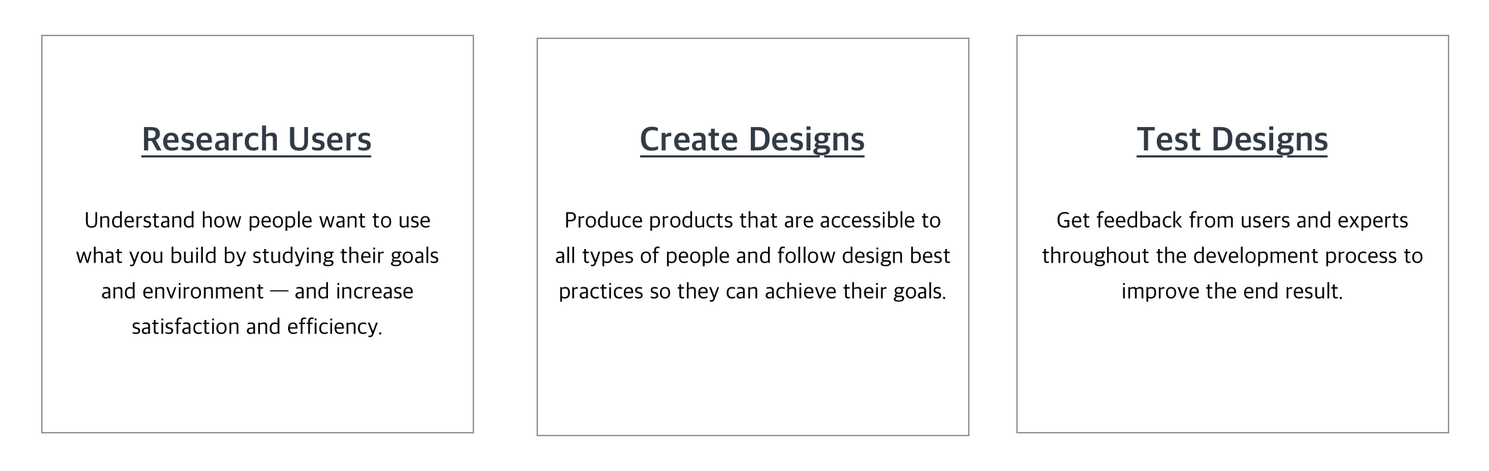
Action Plan Content team to address menu labels – improve recognition of sections. Visual design to highlight banner.
2. Home page and menu bar comments – Home Page
Participants were drawn to the 3 boxes (Research Users, Create Designs, Test Designs) first.
Participants noted that the home page does not look like a home page. [Test artifact]
Home page does not offer immediate direction to a clinical reminder since that is the overall goal. [Test artifact]
One participant was drawn to the video box and stated they would go there first. Then to the three boxes.
The initial paragraph does not give a sense of what the site is about and who it is for.

Slide 10
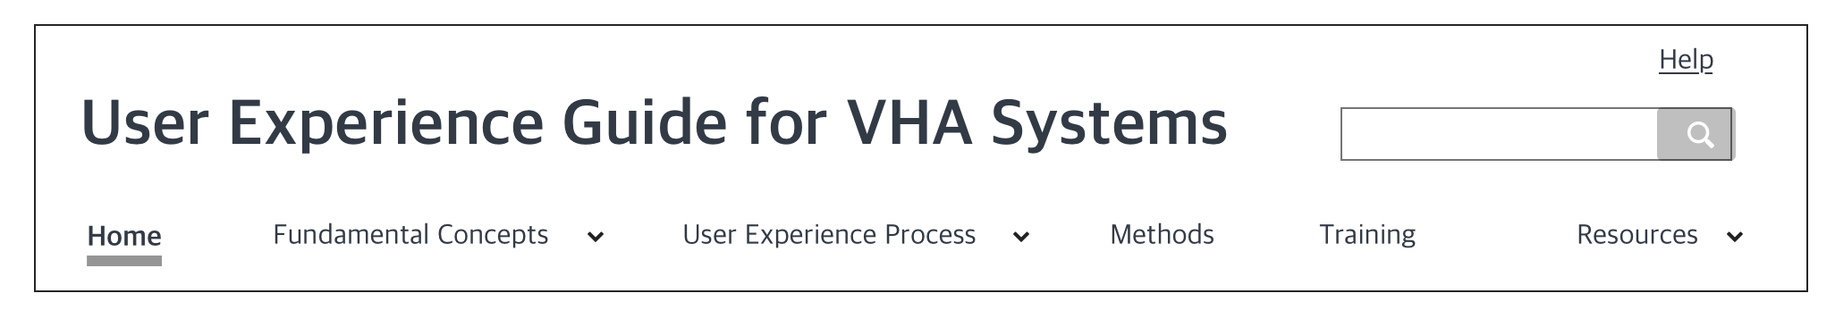
Action Plan Intro to page to include direction to site visitor: start here.
Menu Bar comments
Participants said they would want to know the User Experience Process and Fundamental Concepts before going anywhere else on the site.

Slide 11
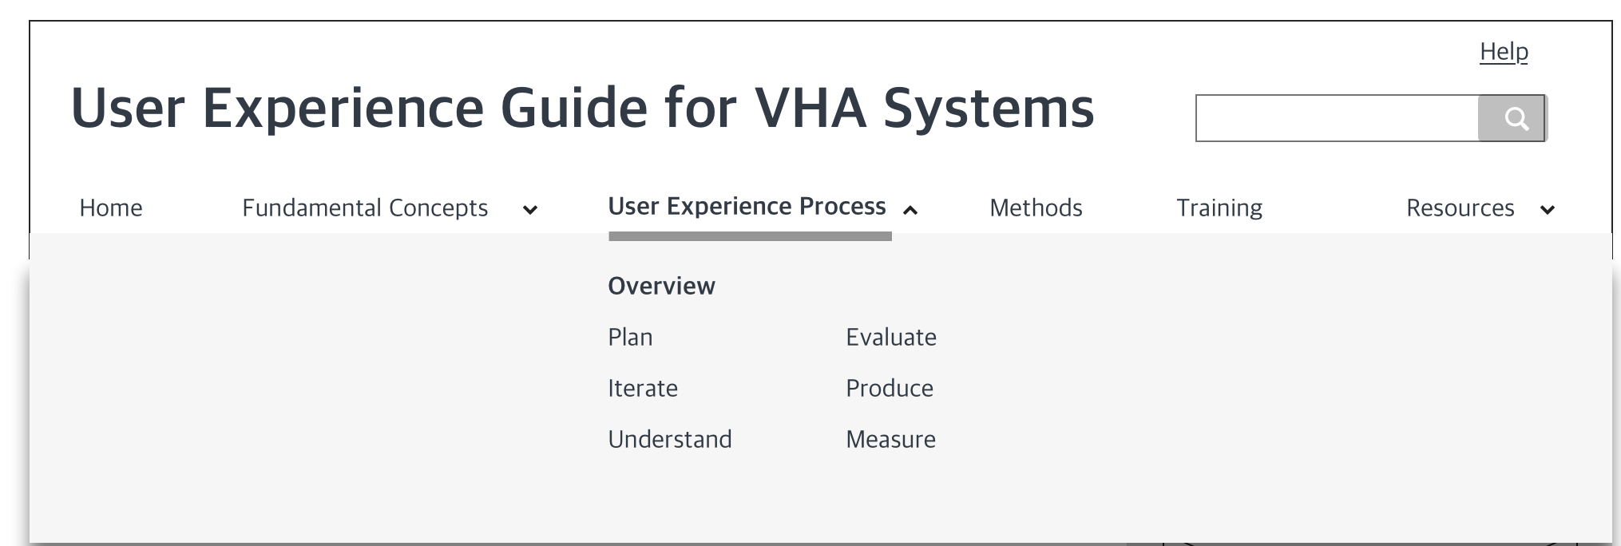
Action Plan IA will adjust the process submenu to reflect the phases in the UX process.
User Experience Process tab
Participant commented that it was odd having the items in this drop down be 2 columns rather than 1.
Note that the items here do not mirror the steps in the diagram.
There was also a comment: “I wouldn’t know the difference between User Experience Process and Methods. I guess this would provide more than one avenue to get to the same thing.”

Slide 12
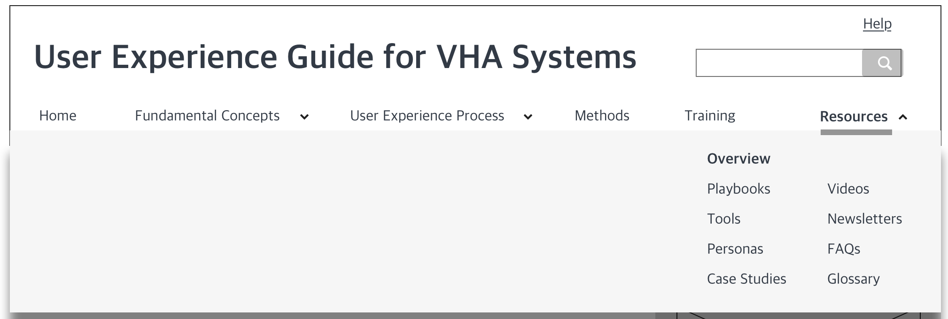
Action Plan Evaluation of FAQ section will drive using a search and/or categories for that feature. Menu labels will be edited.
Resources tab
Most of the participants (4/6) did not know what Playbooks, Personas, or Case Studies meant on this site.
One participant commented that FAQs would be helpful if it was designed with a search bar, not Table of Contents format (in a list, requiring scrolling).
One person commented that videos are useful to break up the text.

Slide 13
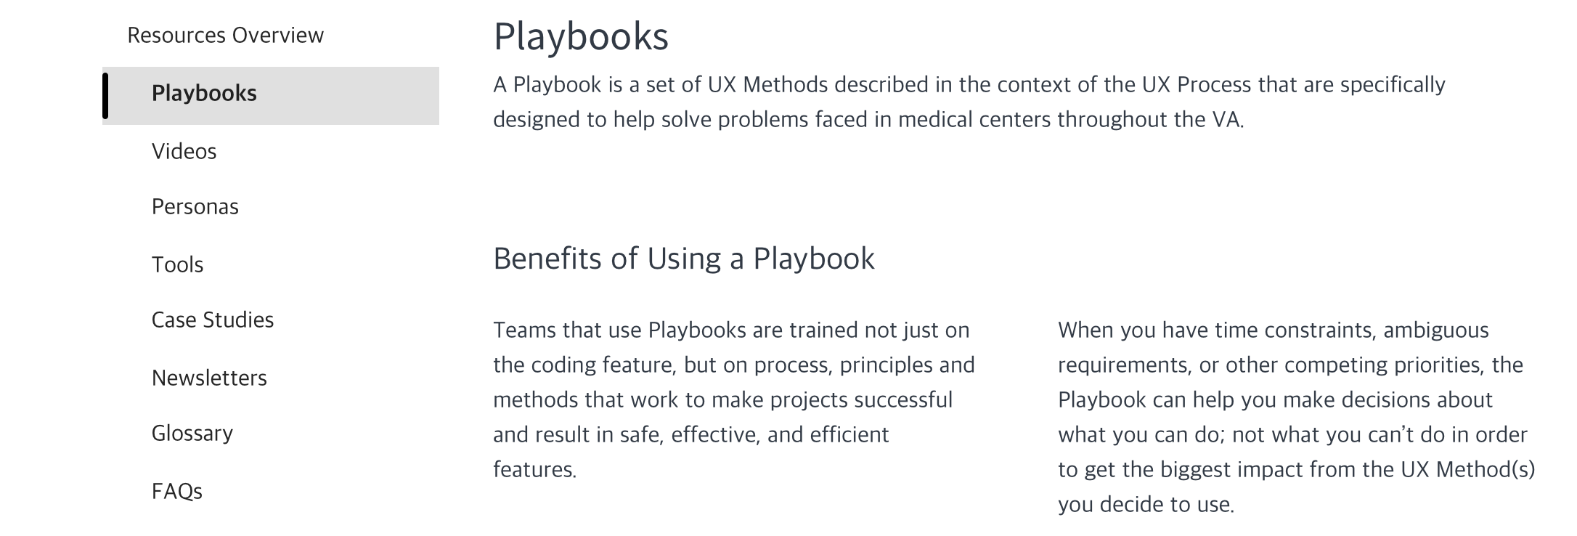
Action Plan Content will be edited to clarify the use of each section.
3. Playbooks page and Creating a CRDT page comments
Participant was confused as to why the paragraphs under Benefits were split into 2 sections instead of being left as one large paragraph.
Terms on this page that participants wanted hover definitions or pop-up windows (UX Methods, UX Process).
One participant related playbook to the common meaning.
One participant said, “I think this section would include some of the same things I would have expected in Fundamental Concepts and User Experience Process.”
Participant said that they still didn’t understand what a Playbook was even after reading this page.

Slide 14
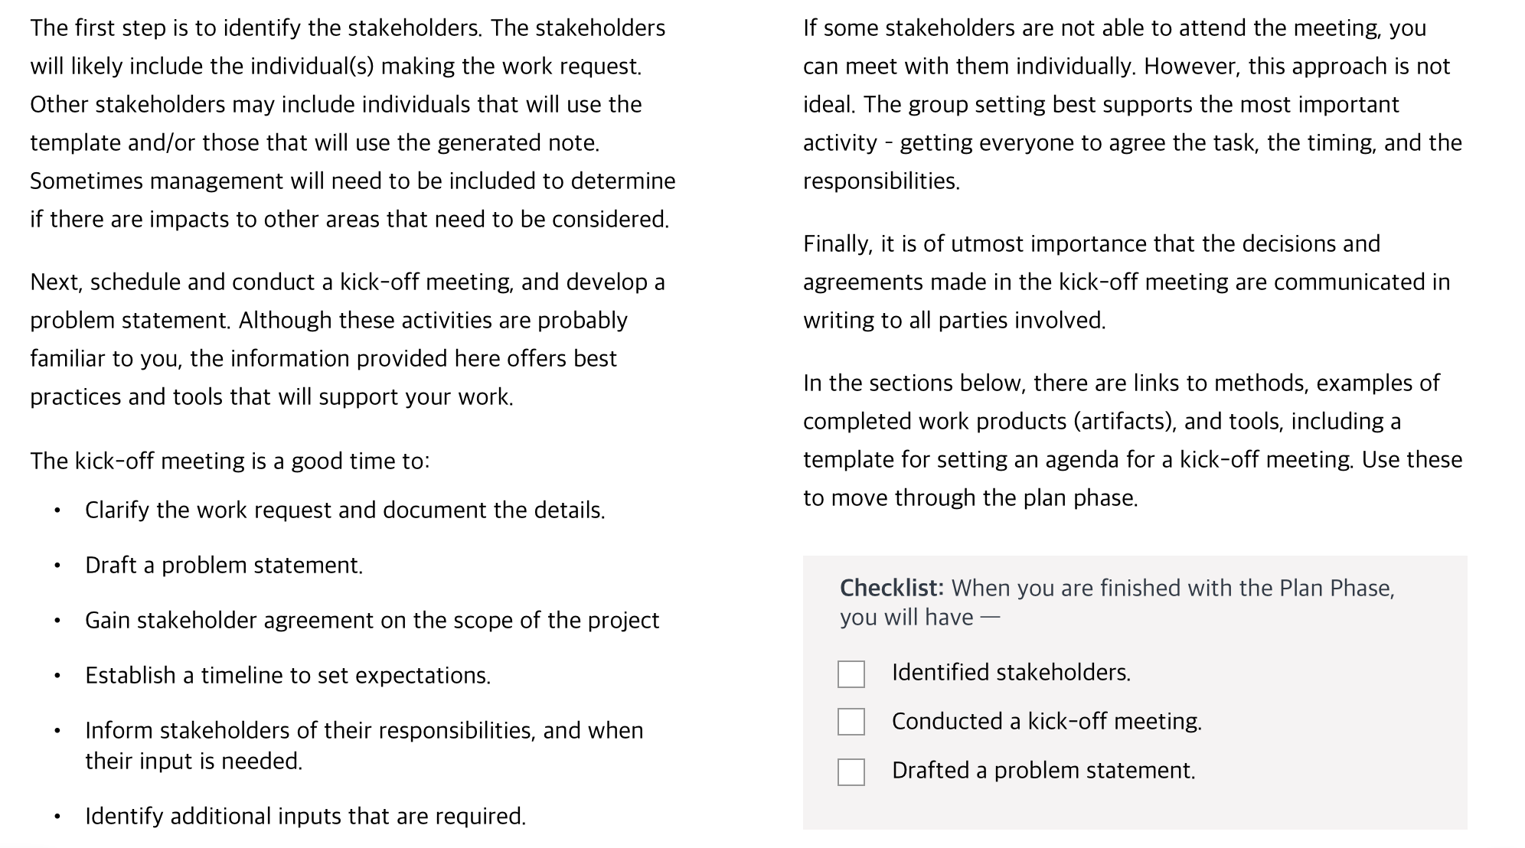
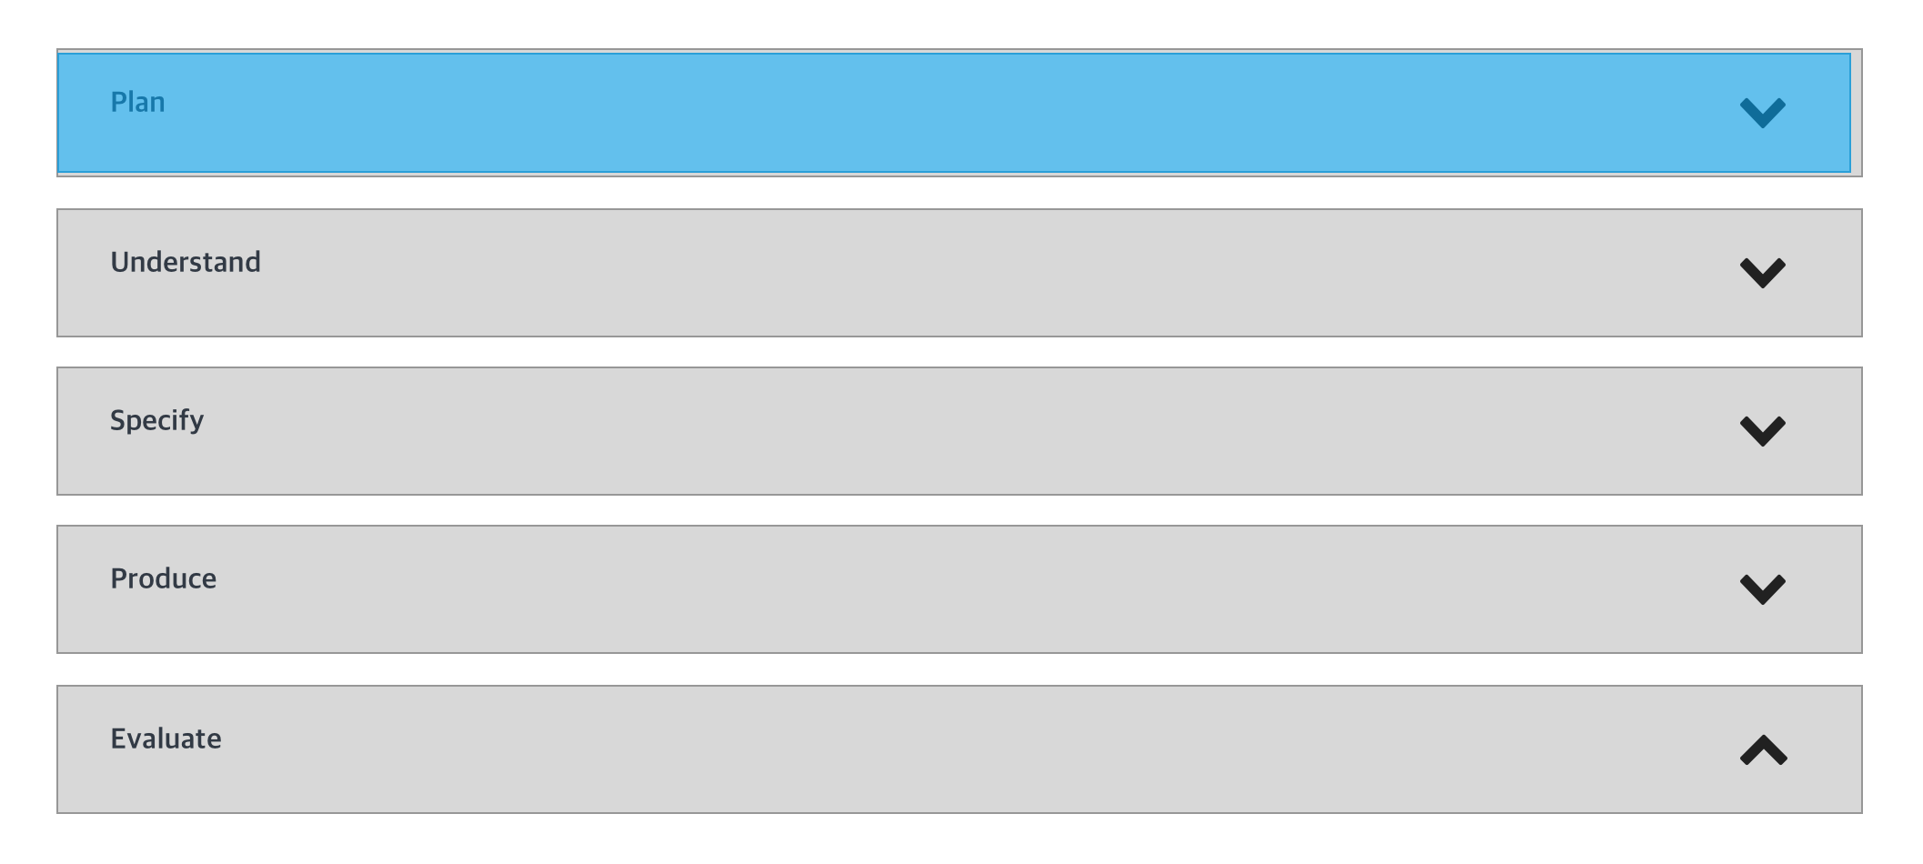
Action Plan IA and content team are developing some alternate routes for site visitors. New content will emphasize action over rationale, history and choices.
Process Overview section comments
Participants commented that there is a lot of text on this page and that each of the bars with drop-down arrows suggest large sections to read.
Many commented that bullet points and visual diagrams or workflows would be more useful than paragraph text.
Participants commented on the Plan section being very text heavy.

Slide 15
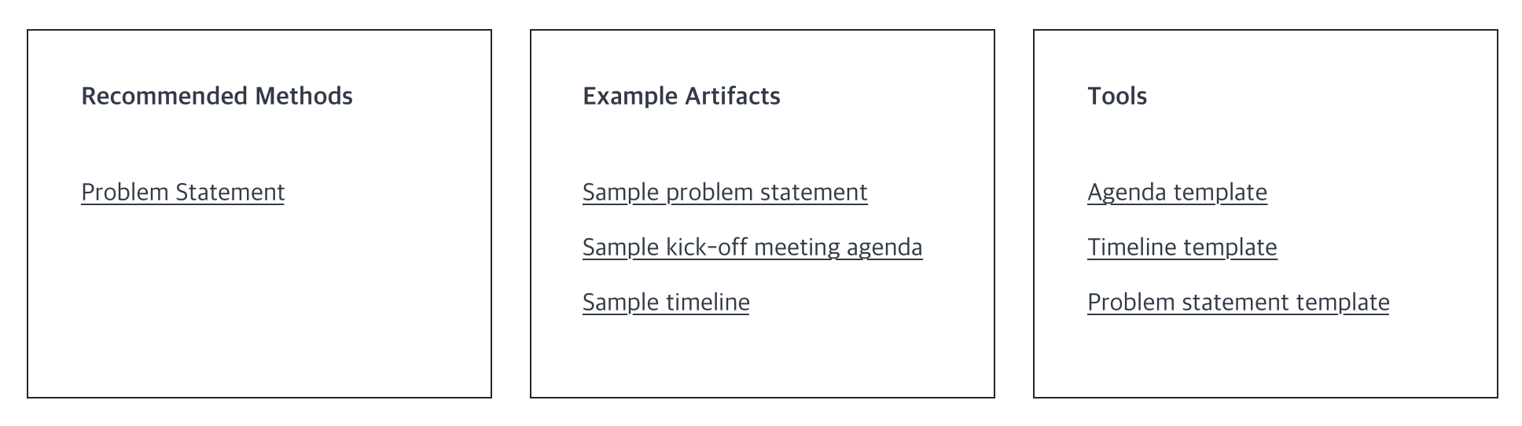
Action Plan CAC workflow mapping will be completed. Missing key steps will be addressed. Role of data collection and retrieval will be highlighted in the Reminder configuration section.
Plan section comments
CAC participant noted that it is not clear what the goal of the clinical reminder is, collecting specific data.
Also mentioned that there should be another step after “Drafted a problem statement” in the checklist to include a step about reviewing the draft with the stakeholders.
One participant did not see the connection between Recommended Methods and Problem Statement and would use the items in the Artifacts and Tools boxes before the Methods box.
Participant said they like the order with the diagram, then bullet points, then more detailed paragraphs, but that they don’t see how it connects to a playbook.

Slide 16
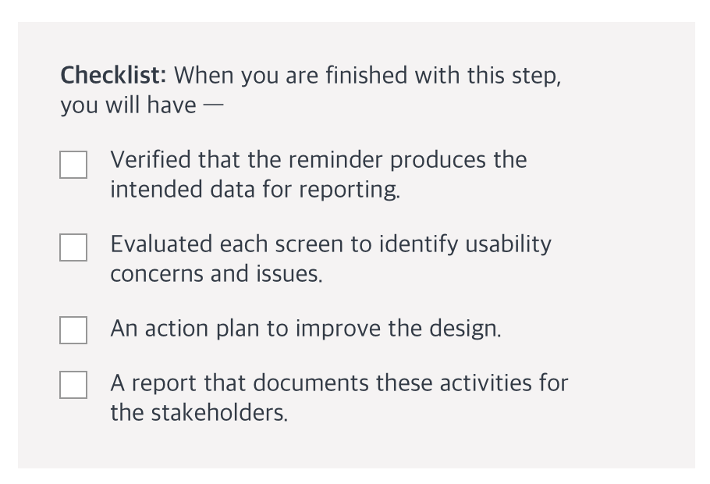
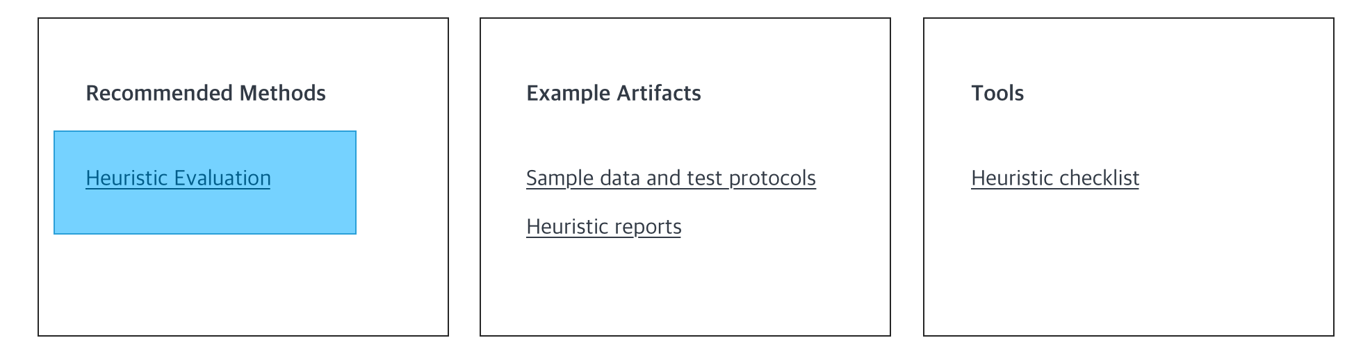
Action Plan The produce and evaluate phase for reminder configuration will be combined, to emphasize the need for user input during the produce phase, not waiting until the work is complete and then difficult to back out.
Evaluate section comments
One participant commented that the step in the Checklist, “An action plan to improve the design” should come before the Evaluate step, in the Specify step of the diagram instead, because the design should be solid before it is produced.
Others commented that they did not know what a Heuristic Checklist was and wondered if it was the same as the Evaluate step checklist.
CAC participant indicated the data collection goal should be mentioned earlier than this step.
Participant said the checklist needs a step to communicate with the end-user by means of survey/interview/observation to see how they create a reminder themselves.

Slide 17
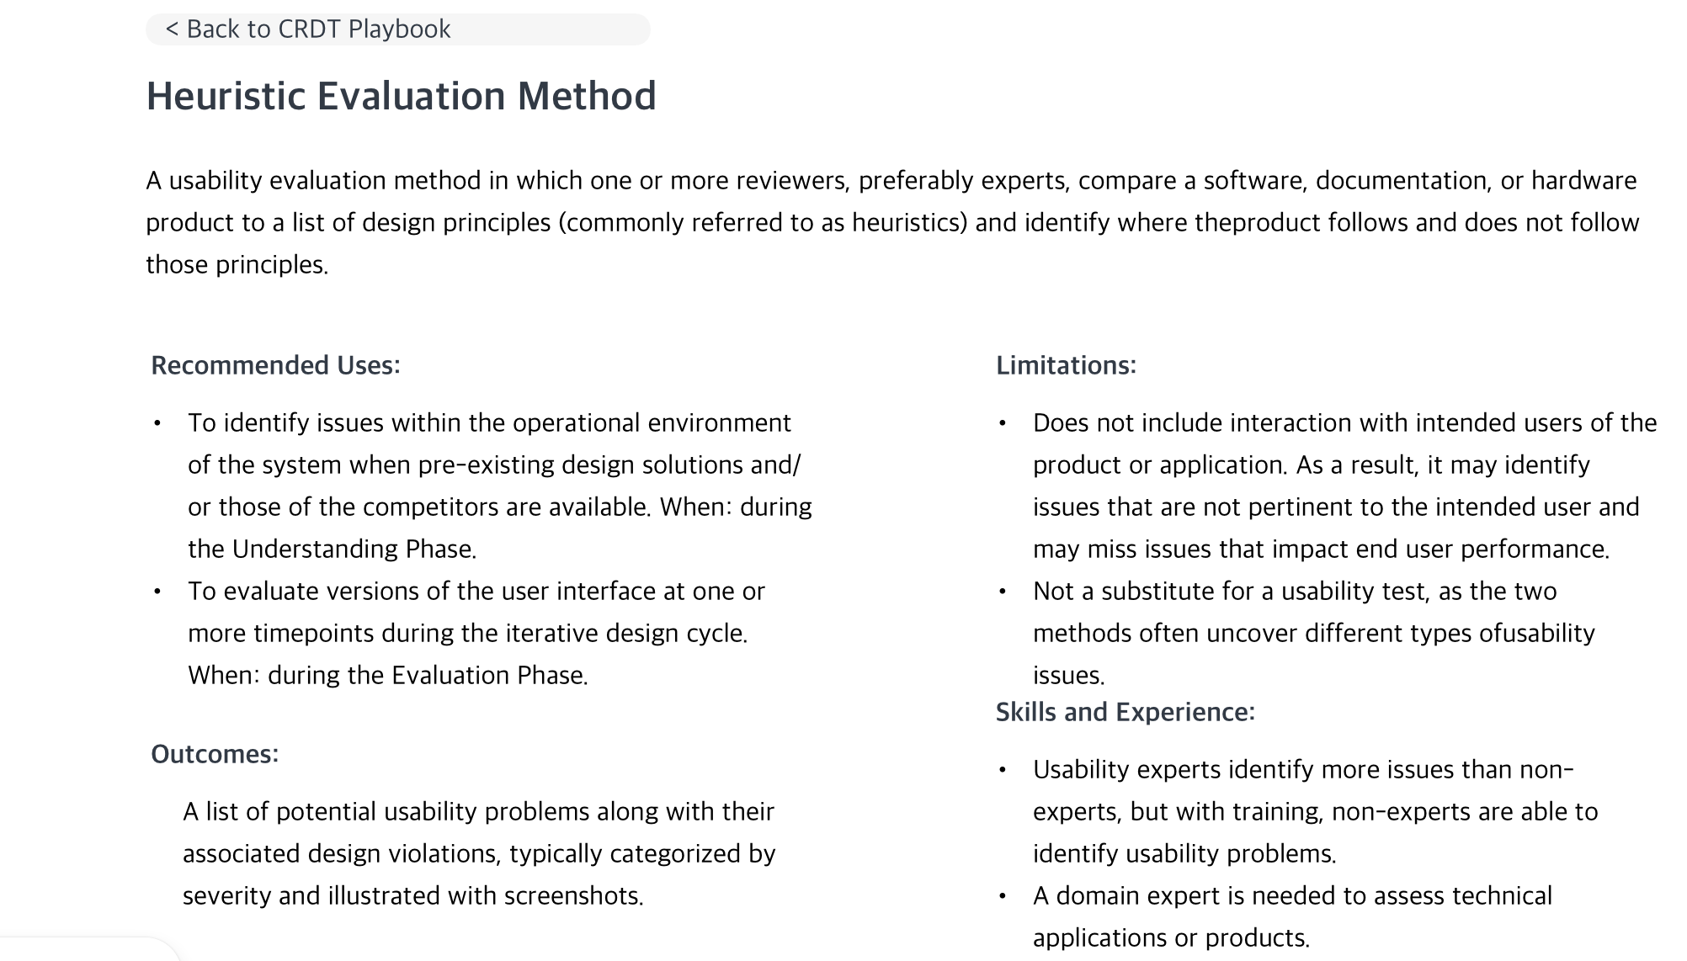
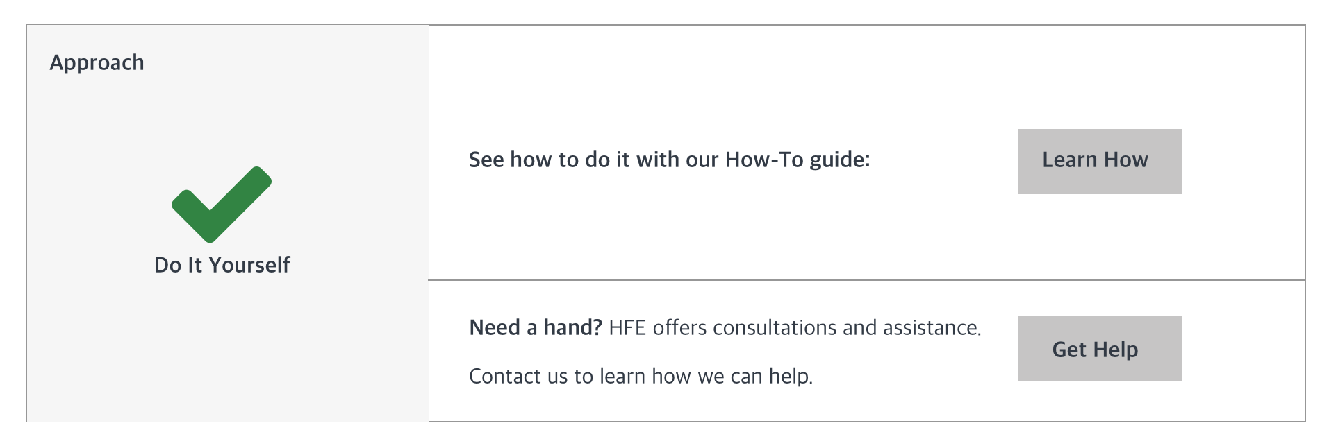
Action Plan The approach section will be redesigned to be more clear, and to be in agreement with the Method text.
4. Heuristic Evaluation Method page comments
One participant did not think that “Do It Yourself” and “Need a hand?” made sense together, but others did not have this issue.
Note that in the Method description it states the evaluation is best if done by an expert.
Another participant did not understand that the Approach box leads to the How-to guide. It was not intuitive.
Nurse informaticist: We call this an “independent double check” when reading about using multiple evaluators.
One participant said they still did not understand what heuristics entail after reading the titled sections with bullet points.
Participant also felt disoriented and that they needed heuristics to be restated.

Slide 18
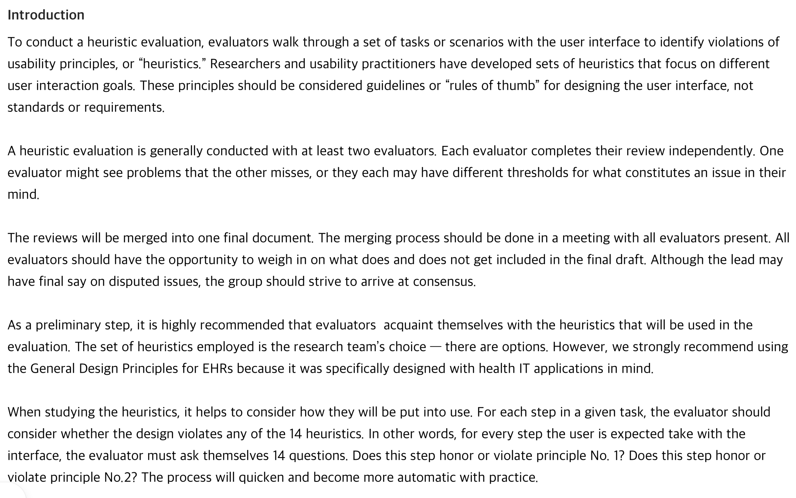
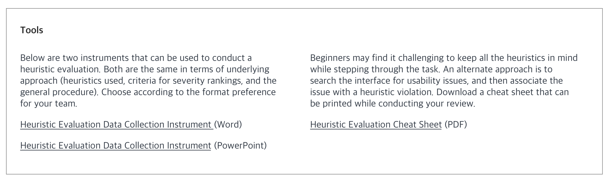
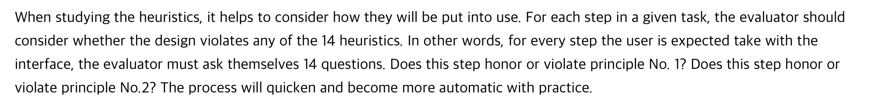
Action Plan How To guides will be reformatted to focus more on cookbook type steps.
How-To guide comments
Many noted again that this page is very wordy and bullet points would be better. Commented they would skim the text and go straight to Tools for examples.
Someone commented that the word “violations” is very strong.
Most of the participants (4/6) expected to see the 14 heuristics listed. Two people saw the links in the Tools section at the bottom and said they should be presented earlier on the page and that they would skip the text and go straight to the cheat sheets.
Participant said: “Now I’m starting to feel lost because I can’t link the topics. Out of sight out of mind.”

Slide 19
Action Plan
How-To guide comments
Someone commented that they would like a sample workflow analysis included in the Tools section to help understand the process of doing an evaluation.

Slide 20
5. General Site comments
“Needs to be less overwhelming. One page I could print.”
Participants thought the entire site would be best for someone new to their job.
Informaticist thought it would be good for someone who had no project management training or experience.
It would be more helpful if the information on the site more accurately mirrored the actual tasks of the job.
It would be helpful if there were suggestions and feedback on the site for how to fix issues after things have been built.
Several participants thought this was an AGILE process being described.
Participant advocated for a more user-centered design that limits cognitive burden, and increases motivation to use the site as intended, resulting it meaningful data.
So many child pages that link to the parent page is overwhelming and tiring. “The more someone has to scroll, the more it adds to cognitive burden.”
NI Participant found this site to be extremely valuable and would recommend it to other colleagues.

Slide 21
Action Plan Consider need for ADPAC support as part of team approach.,
6. Lab ADPAC Comments
Lab ADPAC is responsible for the data coming from lab equipment (test results) to the EHR. Example: New COVID-19 antibody test (current work). Lab Manager informs ADPAC. ADPAC may reach out to the test provider (Roche) and obtain information such as how to code results.
Currently on a team that includes a CAC and Infection Control to determine rules for ordering COVID-19 tests based on inventory, days to result, etc.
Asked if their work goes through any type of QA, everyone said no except this participant:
Lab ADPAC noted that the lab manager does QA the work and informs them if there are discrepancies. This is 50% of the Lab ADPAC workload.
The lab manager crosschecks the data with the lab instruments.
Lab ADPAC has access to test patient data and does perform some testing.
ADPAC could use support on form design for work requests: panel vs single test, how results should be shown, out of range, etc.

Slide 22
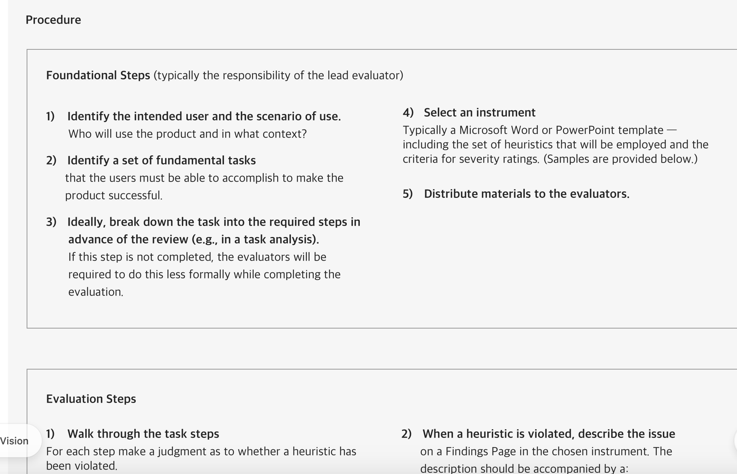
7. Requests
Should not say more than one heuristic, just say this is the one we use.
Have playbooks for other tasks, not just clinical reminders, since “those will be a thing of the past soon.”
Make the How-To Procedure section a printable checklist.

